Slide 1
Data Structures
14. Heap (Priority Queues)

Slide 2
Motivation
With queues the order may be summarized by first in, first out
Some tasks may be more important or timely than others
Higher priority
Priority queues
Enqueue objects using a partial ordering based on priority
Dequeue that object which has highest priority

Slide 3
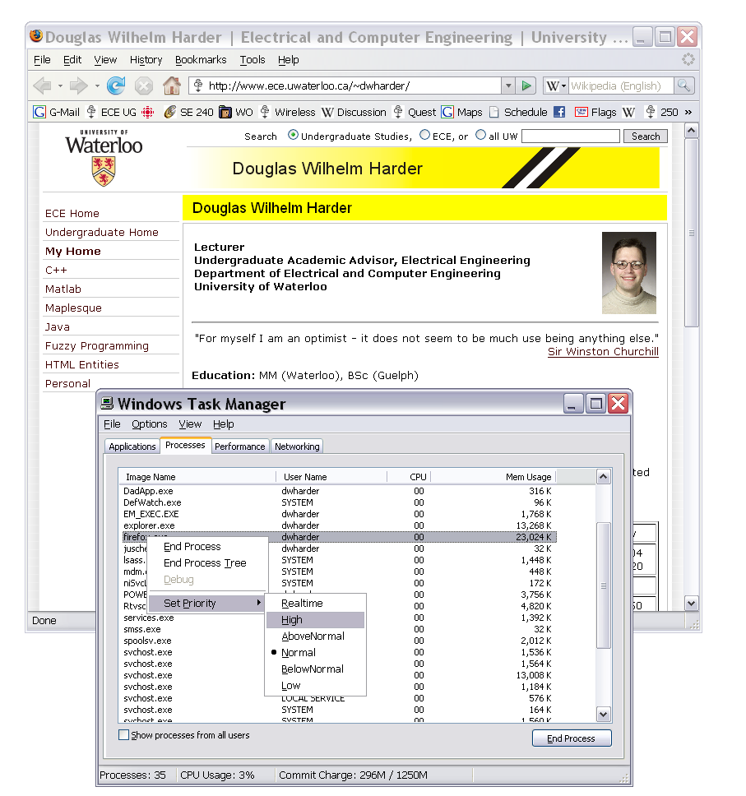
Applications Of Priority Queue
Hold jobs for a printer in order of length
Store packets on network routers in order of urgency
Ordering CPU jobs
Emergency room admission processing
The priority of processes in Windows may be set in the Windows Task Manager

Slide 4
Priority Queue – ADT
insert (i.e., enqueue)
Dynamic insert
Specification of a priority level (0-high, 1,2.. Low)
deleteMin (i.e., dequeue)
Returns the current “highest priority” element in the queue
Element with the minimum priority level
Deletes that element from the queue
Performance goal is to make the run time of each operation as close to O(1) as possible

Slide 5
Priority Queue – ADT
4
10
19
5
3
13
8
11
22
insert()
deleteMin()
3
Dequeues the next element with the highest priority

Slide 6
Simple Implementations
Unordered linked list
Insert – O(1) step
deleteMin – O(n) steps
Ordered linked list
insert – O(n) steps
deleteMin – O(1) step
Balanced binary tree, e.g., AVL Tree
insert – O(log₂ n) steps
deleteMin in how many steps?
Find min – O(log₂ n) steps
Delete – O(log₂ n) steps
5
2
10
…
3
2
3
5
…
10
Can we build a data structure better suited to store and retrieve priorities?
Notes:
Erases may require O(h) corrections
These corrections require O(1) time
Depth is O( ln(n) )
∴ all O(h) operations are O( ln(n) )

Slide 7
Binary Heap

Slide 8
Binary Heap
A binary heap is a binary tree with two properties
Structure property
Heap-order property

Slide 9
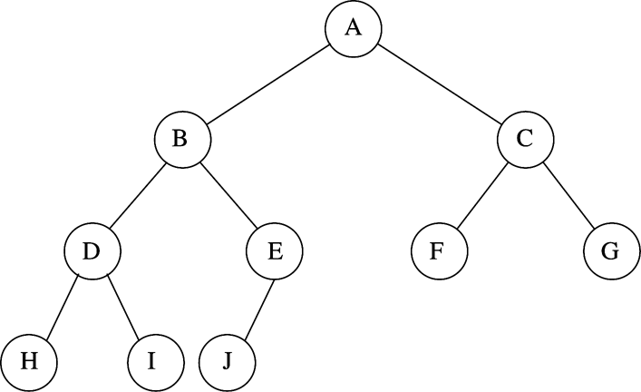
Binary Heap – Structure Property
A binary heap is (almost) complete binary tree
Each level (except possibly the bottom most level) is completely filled
The bottom most level may be partially filled (from left to right)
N=10
Every level (except last) saturated

Slide 10
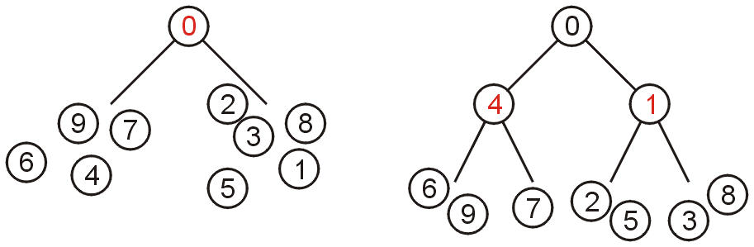
Binary Heap – Heap-Order Property
Min-Heap property
Key associated with the root is less than or equal to the keys associated with either of the sub-trees (if any)
Both of the sub-trees (if any) are also binary min-heaps
Properties of min-heap
A single node is a min-heap
Minimum key always at root
For every node X, key(parent(X)) ≤ key(X)
No relationship between nodes with similar key

Slide 11
Binary Heap – Heap-Order Property
Max-Heap property
Maximum key at the root
For every node X, key(parent(X)) ≥ key(X)
Insert and deleteMin must maintain heap-order property

Slide 12
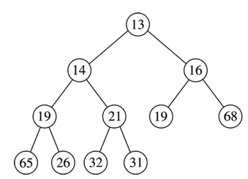
Heap-Order Property – Example
Min-Heap
Minimum element
≤
≤
≤
≤
≤
≤
≤
≤
≤
≤
No relationship

Slide 13
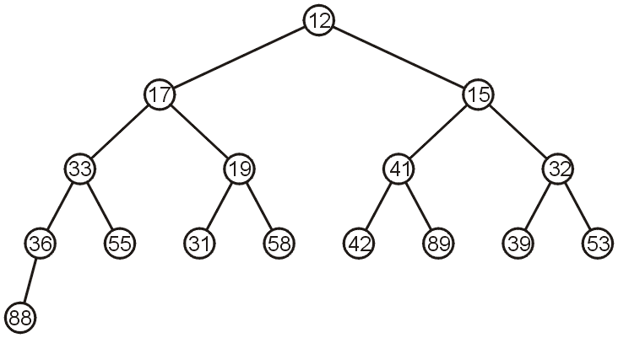
Heap Operations – insert
Insert new element into the heap at the next available slot (“hole”)
Maintaining (almost) complete binary tree
Percolate the element up the heap while heap-order property not satisfied

Slide 14
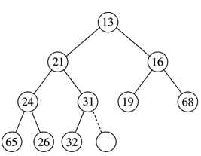
Heap Insert – Example
Insert 14
14
hole

Slide 15
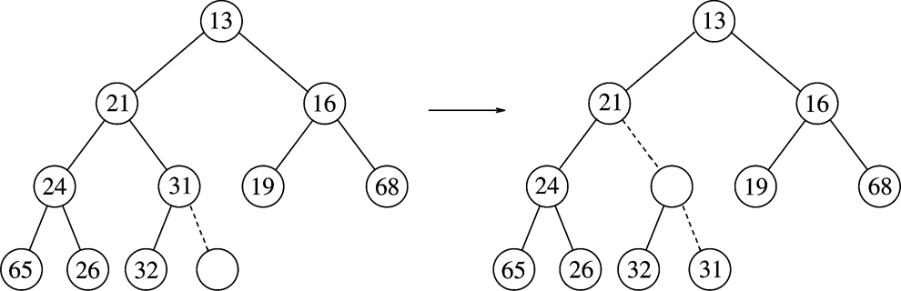
Heap Insert – Example
Insert 14
(1) 14 vs. 31
14
14
hole

Slide 16
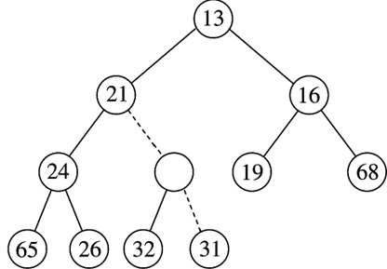
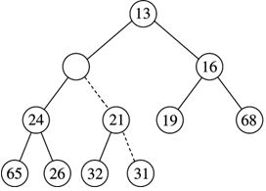
Heap Insert – Example
Insert 14
(2) 14 vs. 21
14
14

Slide 17
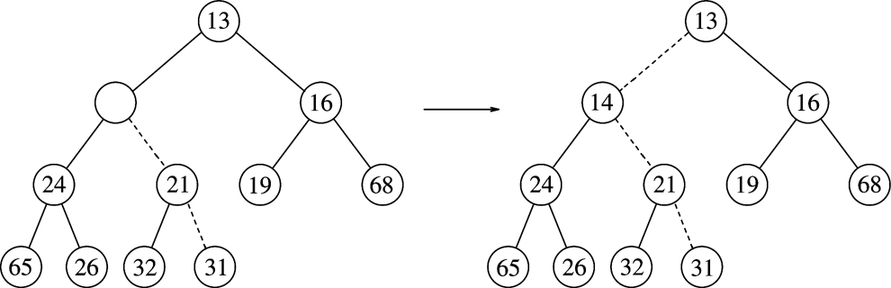
Heap Insert – Example
Insert 14
(3) 14 vs. 13
14
Path of percolating up
Heap order property
Structure property

Slide 18
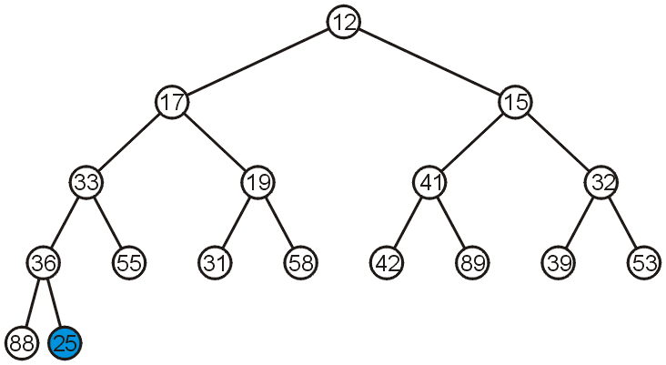
Heap Insert – Example
Insert 25

Slide 19
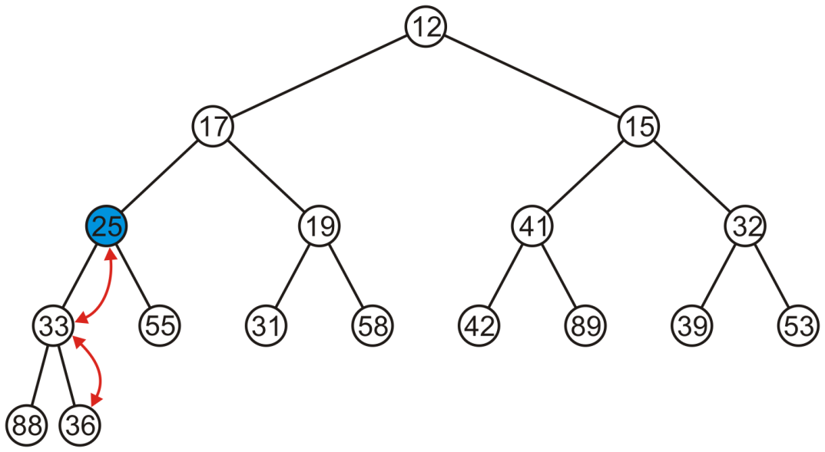
Heap Insert – Example
Percolate 25 up into its appropriate location
The resulting heap is still a complete tree

Slide 20
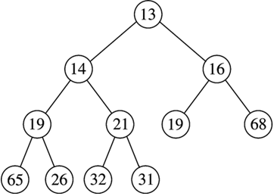
Heap Operation – deleteMin
Minimum element is always at the root
Return the element at the root and delete it
Heap decreases by one in size
Move last element of the tree into hole at root
Percolate down while heap-order property not satisfied
Make this position empty

Slide 21
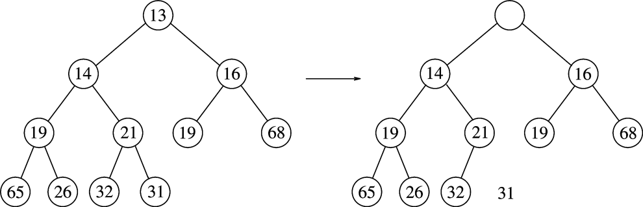
deleteMin – Example
Copy 31 temporarily here and move it down
Make this position empty
Is 31 > min(14,16)?
- Yes - swap 31 with min(14,16)

Slide 22
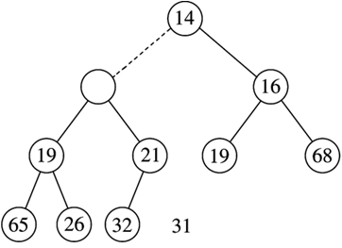
deleteMin – Example
31
Is 31 > min(19,21)?
- Yes - swap 31 with min(19,21)

Slide 23
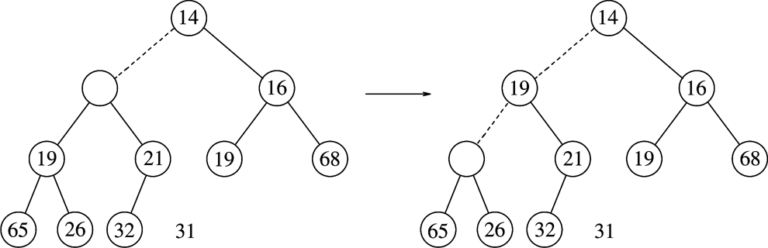
deleteMin – Example
31
31
Is 31 > min(19,21)?
- Yes - swap 31 with min(19,21)
Is 31 > min(65,26)?
- Yes - swap 31 with min(65,26)

Slide 24
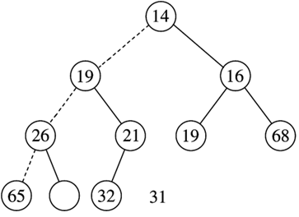
deleteMin – Example
31

Slide 25
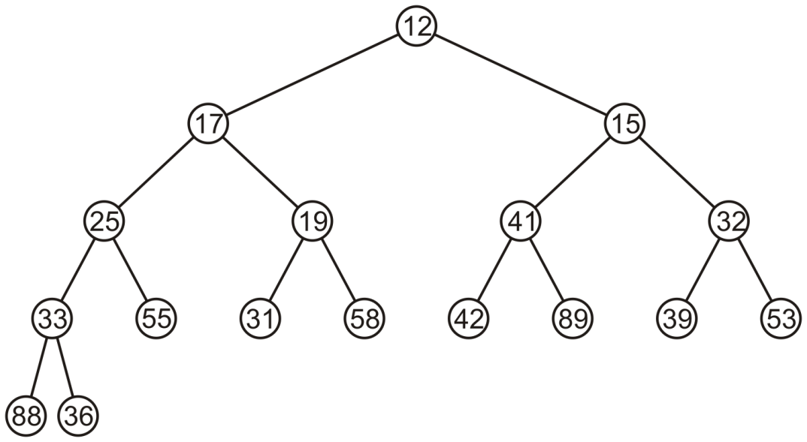
deleteMin – Example
deleteMin will dequeue element 12 from the top

Slide 26
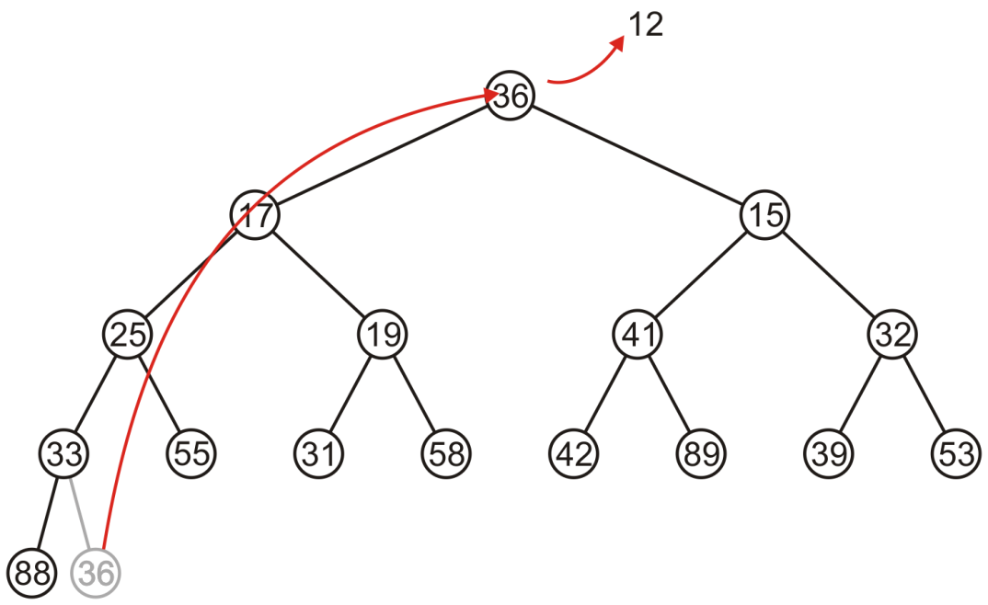
deleteMin – Example
Copy the last entry in the heap to the root

Slide 27
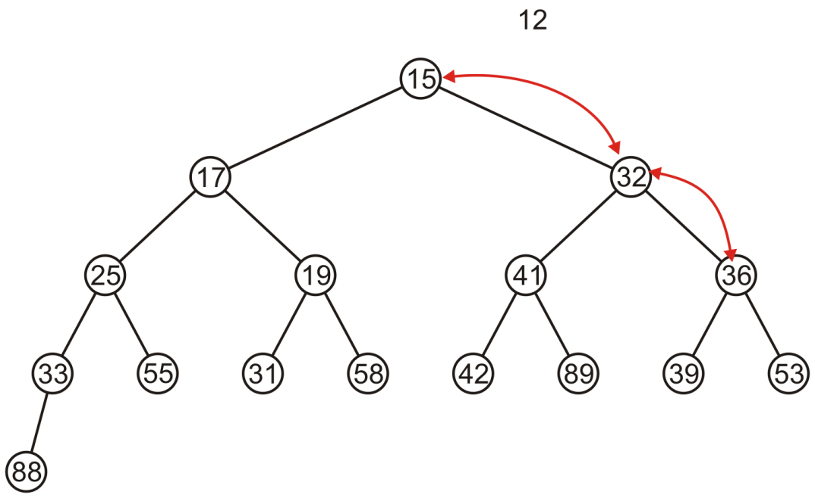
deleteMin – Example
Percolate 36 down swapping it with the smallest of its children
Halt when both children are larger

Slide 28
Array-Based Implementation Of Binary Tree
Left child(i) = at position 2i
Right child(i) = at position 2i + 1
Parent(i) = at position
N=10
Array representation:
i
2i + 1
2i

Slide 29
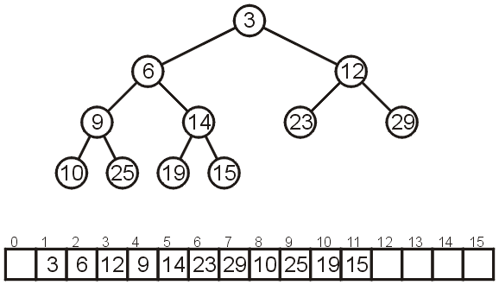
Array-Based Implementation Of Binary Heap
Consider the following heap, both as a tree and in its array representation

Slide 30
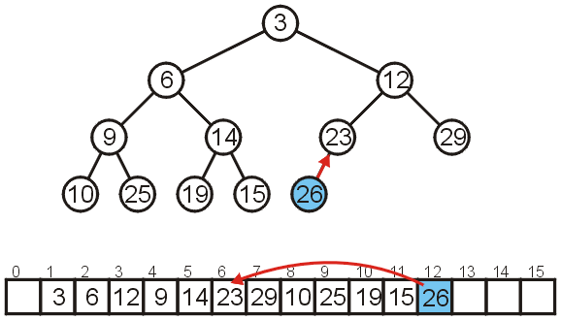
Array-Based Implementation – insert
Inserting 26 requires no changes

Slide 31
Array-Based Implementation – insert
Inserting 8 requires a few percolations
Swap 8 and 23
8
8

Slide 32
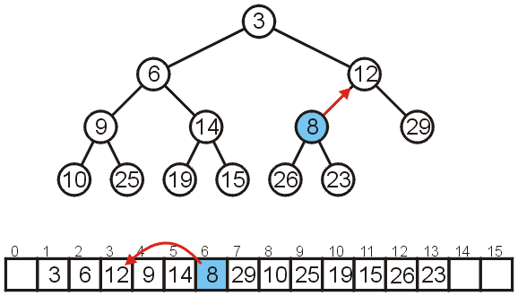
Array-Based Implementation – insert
Swap 8 and 12

Slide 33
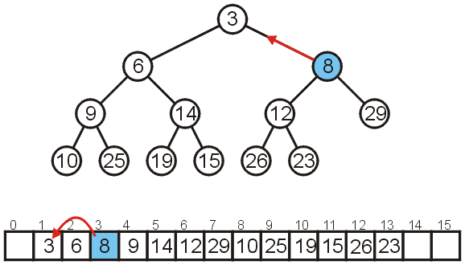
Array-Based Implementation – insert
At this point, 8 is greater than its parent, so we are finished

Slide 34
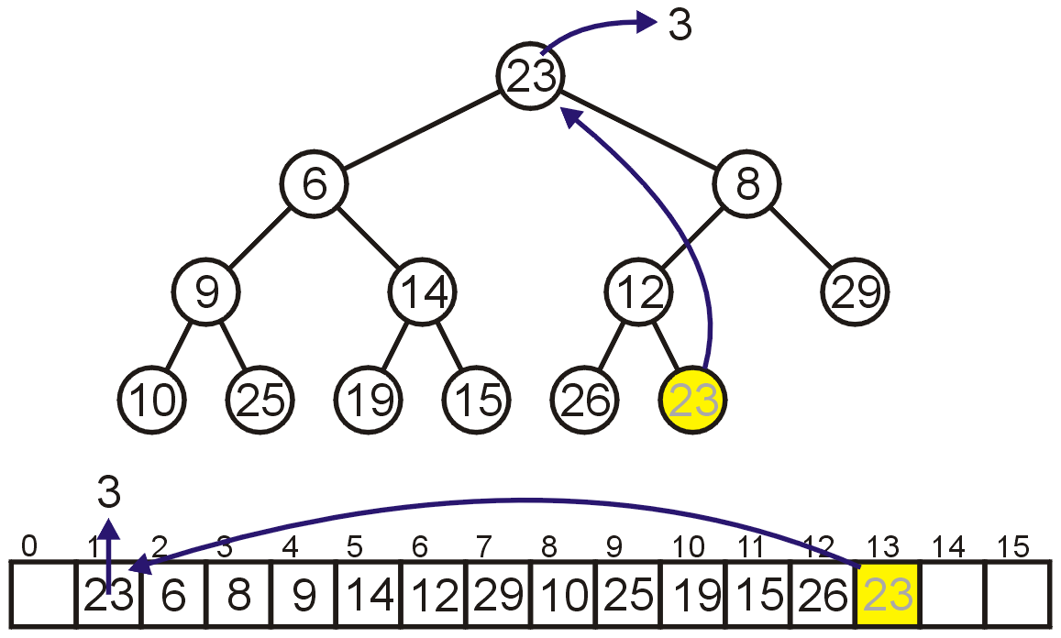
Array-Based Implementation – deleteMin
Removing the top require copy of the last element to the top

Slide 35
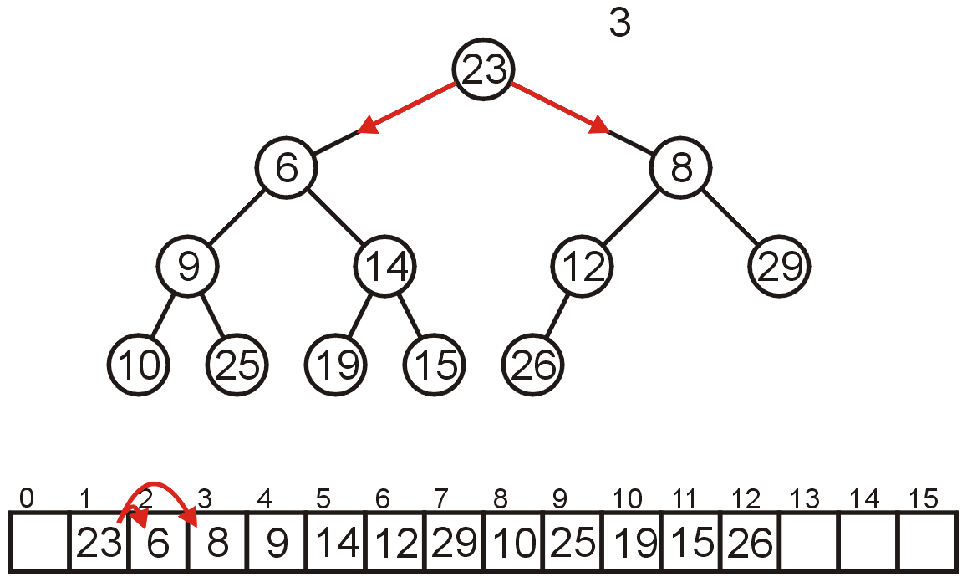
Array-Based Implementation – deleteMin
Percolate down
Compare Node 1 with its children: Nodes 2 and 3
Swap 23 and 6
Left child(i) = at position 2i
Right child(i) = at position 2i + 1

Slide 36
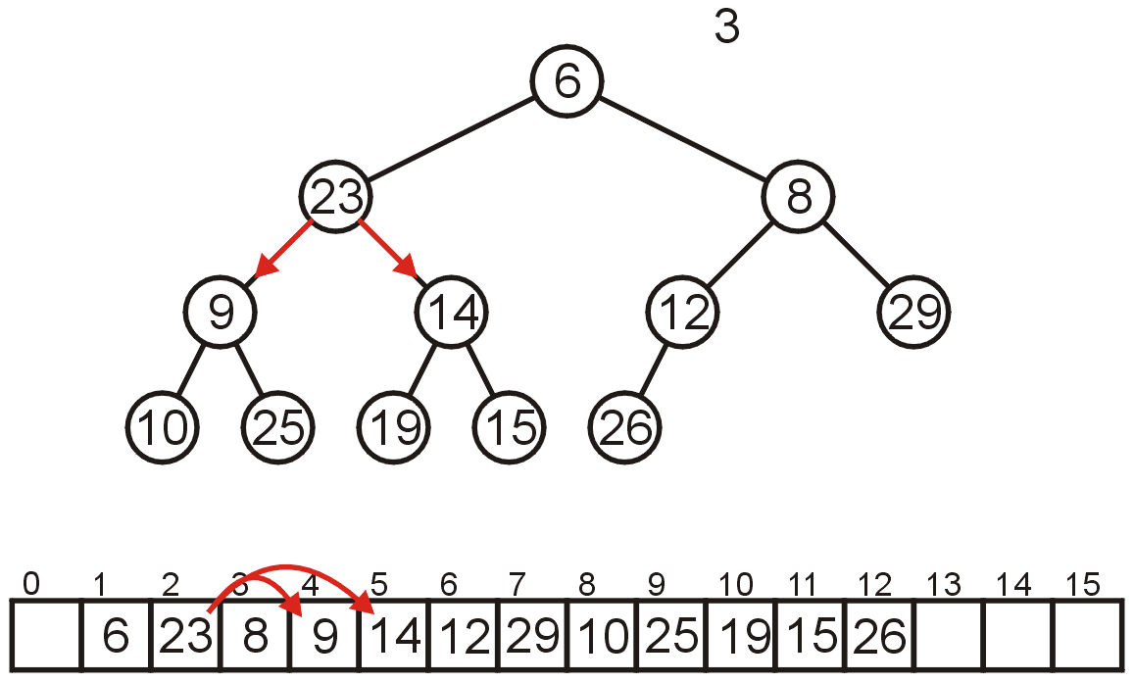
Array-Based Implementation – deleteMin
Compare Node 2 with its children: Nodes 4 and 5
Swap 23 and 9
Left child(i) = at position 2i
Right child(i) = at position 2i + 1

Slide 37
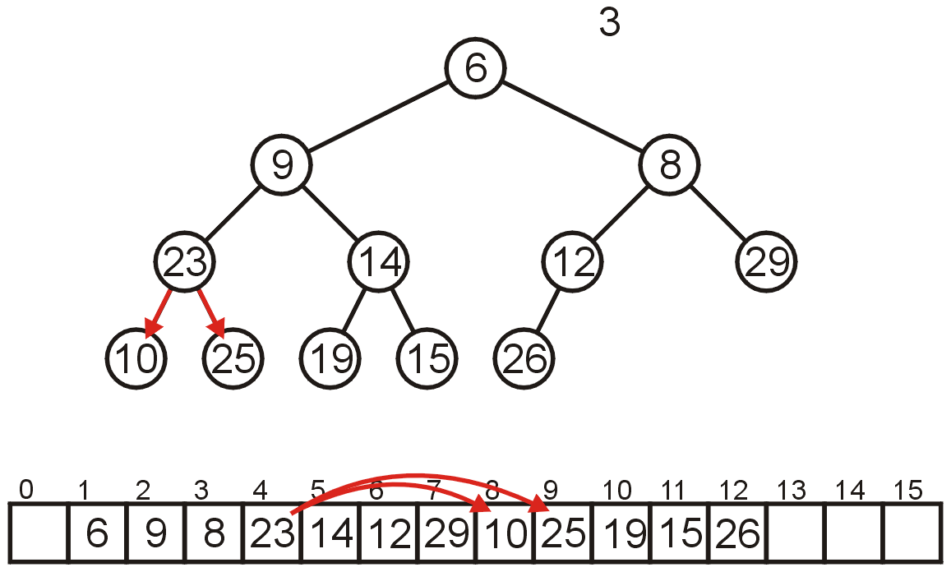
Array-Based Implementation – deleteMin
Compare Node 4 with its children: Nodes 8 and 9
Swap 23 and 10
Left child(i) = at position 2i
Right child(i) = at position 2i + 1

Slide 38
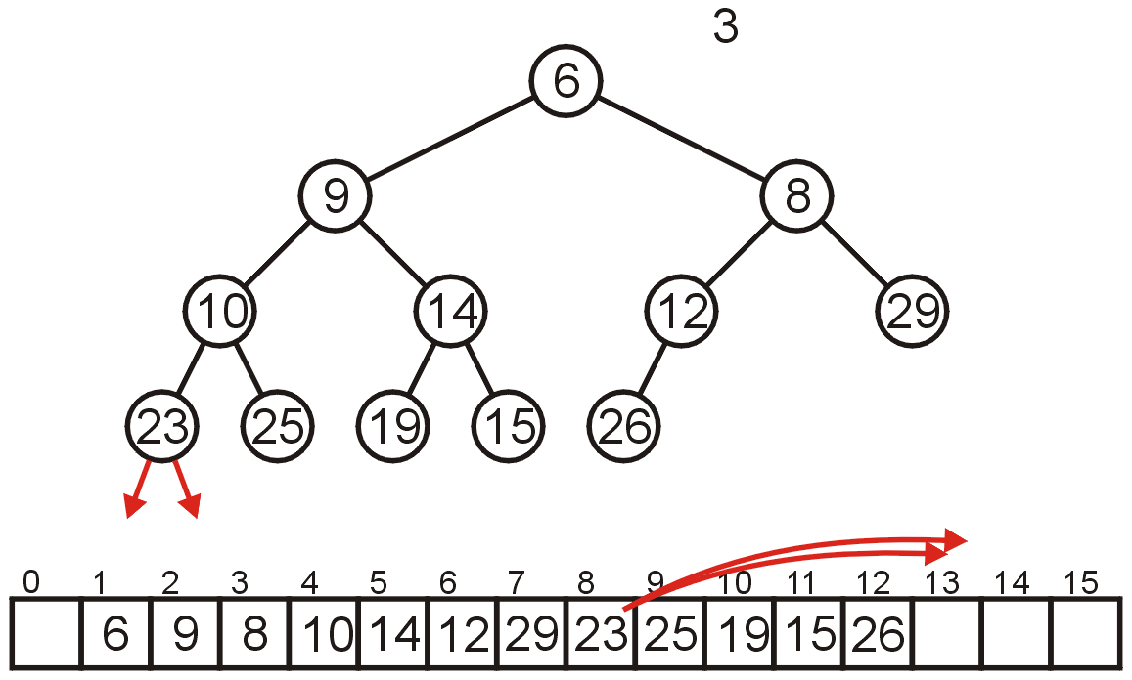
Array-Based Implementation – deleteMin
The children of Node 8 are beyond the end of the array:
Stop
Left child(i) = at position 2i
Right child(i) = at position 2i + 1

Slide 39
Runtime Analysis
insert operation
Worst case: Inserting an element less than the root
O(log₂ n)
Best case: Inserting an element greater than any other element
O(1)
Average case: O(1)
Why ?
deleteMin operation
Replacing the top element is O(1)
Percolate down the top object is O(log₂ n)
We copy something that is already in the lowest depth
It will likely be moved back to the lowest depth
Notes:
Average for binary heap insert O(1)
With each percolation, it will move an object past half of the remaining entries in the tree
Therefore after one percolation, it will probably be past half of the entries, and therefore on average will require no more percolations
Average of binary heap delete is O(log n) same as worst case
Average and worst case complexity of AVL delete and insert is O(log n)

Slide 40
Building a Heap
What if all N elements are all available upfront?
Construct heap from initial set of N items
Solution 1 (insert method)
Perform N inserts
Solution 2 (BuildHeap method)
Randomly populate initial heap with structure property
Perform a percolate-down from each internal node
To take care of heap order property

Slide 41
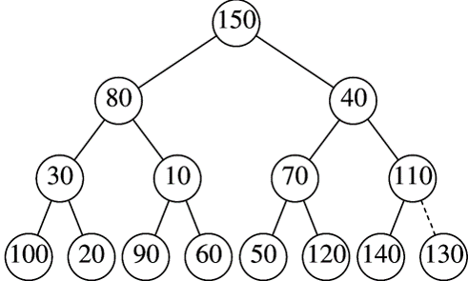
BuildHeap Example
Input priority levels
{ 150, 80, 40, 30, 10, 70, 110, 100, 20, 90, 60, 50, 120, 140, 130 }
Leaves are all valid heaps (implicitly)
Arbitrarily assign elements to heap nodes
Structure property satisfied
Heap order property violated
Leaves are all valid heaps (implicit)
So, let us look at each internal node, from bottom to top, and fix if necessary

Slide 42
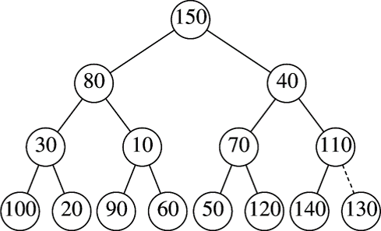
BuildHeap Example
Nothing to do

Slide 43
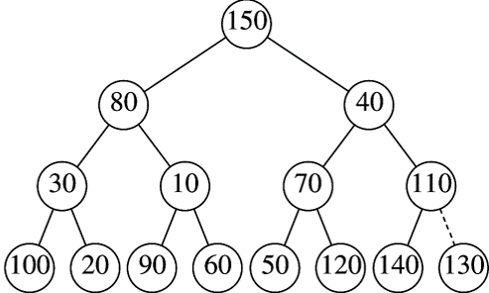
BuildHeap Example
Swap with left child

Slide 44
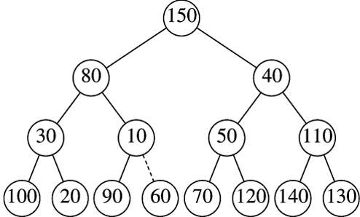
BuildHeap Example
Nothing to do

Slide 45
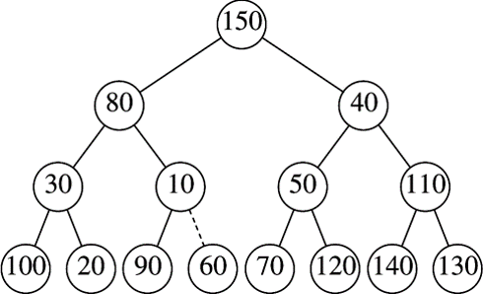
BuildHeap Example
Swap with right child

Slide 46
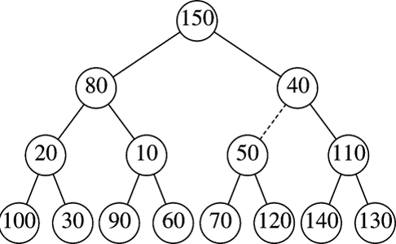
BuildHeap Example
Nothing to do

Slide 47
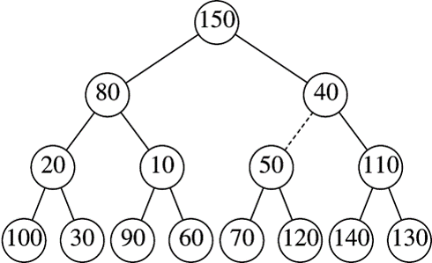
BuildHeap Example
Swap with right child and then with 60

Slide 48
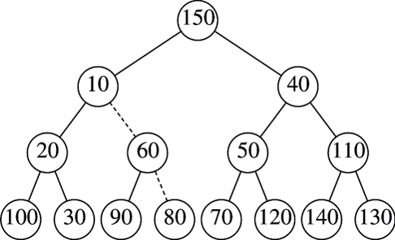
BuildHeap Example

Slide 49
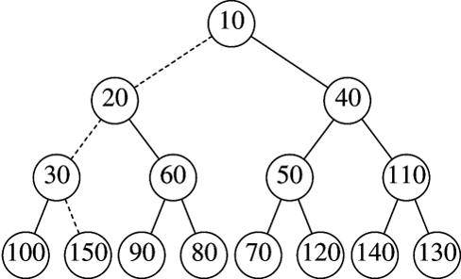
BuildHeap Example
Final Heap

Slide 50
Any Question So Far?

Slide 51
Practice Exercise 1
Write a recursive function isHeap that reads in the level-order (see slide notes) traversal of a binary tree from a file and returns true if the tree is a valid binary min-heap, i.e. the min-heap property is satisfied.
Heap property: the root is smaller than its left and right child, and both left and right subtrees are min heaps too.
Test your code by passing in a binary tree that is a min-heap and another binary tree that is not a min-heap.
Submit (a) your code and both files and (b) a report that includes:
A screenshot of the first (min-heap) file you pass
A screenshot of the output after running the code for the first file
A screenshot of the second (not min-heap) file you pass
A screenshot of the output after running the code for the second file
You can use an array-based or pointer-based implementation of a tree.
Notes:
Marking rubric:
The code will be marked by running your submitted code with your files and confirming that the screenshots indeed match the ones in your report, and also by passing in a min-heap and a non-min-heap file of our own into your program and checking the output.
Level order traversal:
Level-order traversal is what you usually see in an array-based implementation of trees, as given in Lecture 11, slides 6 and 7. For the example in Slide 6, the file would simply read A,B,C,D,E,F,G,H,I. For the example in Slide 7, your input file will read A,B,-,C,-,-,-,D,-,-,-,-,-,-,-,E. You can simply read this into an array (but leave index 0 blank) and consider that array as representing your tree. The first element, A, is the root. A's left child is at 2i and right is at 2i+1 where i represents A's index (which will be 1 for the first element). B's left child will be at 2*2 = 4 (thus Cis its left child) and left will be at 4+1=5, which is a dash representing no entry, which means B has no right child. So on until any left/right child is going out of the bounds of the array.

Slide 52
Practice Exercise 2
Write code to insert an integer sequence read from a file into an initially empty min-heap through (a) the build heap method and (b) the insert method.
Show the result of 2 delete-min operations on the min-heap, one by one.
You can use an array-based implementation of a min-heap.
Submit your file along with your code. Your code should run with any other txt file that contains an integer sequence.
Also include this exercise in your report, i.e. screenshots of the file you pass, the output after build heap and insert methods and the screenshot of the heap after each delete-min operation.

Slide 53
Quiz A
Given a sequence of numbers: 19, 6, 8, 11, 4, 5
Draw a binary min-heap (in a tree form) by inserting the above numbers reading them from left to right
Show a tree that can be the result after the call to deleteMin() on the above heap
Show a tree after another call to deleteMin()
What is the worst-time runtime complexity of building (by insert operation) a binary heap with N elements?

Slide 54
Quiz B
Given a sequence of numbers: 19, 12, 8, 11, 3, 5
Draw a binary min-heap (in a tree form) by inserting the above numbers reading them from left to right
Show a tree that can be the result after the call to deleteMin() on the above heap
Show a tree after a call to insert(4)
What is the worst-time runtime complexity of building (by insert operation) a binary heap with N elements?

